Slide 1
Agency Prepayment: Curtailment
May 2015

Slide 2
Outline
Introduction to Curtailment
Description of Data
Empirical Observations and Comparisons
Description of Framework
Results
Spline Results
Final FIX 30 Curtailment Vector
Going Forward
In Progress: Non 360 Term Loans

Slide 3
Introduction to Curtailment
Standard Curtailment Definition:
Principal reduction that is greater than the standard amortization schedule for that period
Does not include Defaults, Turnover or Refinances
Curtailments Identification:
Curtailments are not explicitly identified in any data source (eMBS Loan Level data or GSE Loan Level data)
Other prepayment types (voluntary vs involuntary) are identified with a flag (GSE) but not in eMBS data
Revised Curtailment Definition:
To estimate curtailments, we must restrict our definition of curtailments by excluding anything where the balance is reduced to zero
This has the drawback that we are excluding full payoffs
It has the benefit of separating curtailments from Defaults, Turnover and Refinances (as they reduce the balance to 0)
Curtailment Empirical Formulas:
GSE: abs(balance difference + scheduled principal pmt < 0)
eMBS: 1 – current balance / scheduled amortization balance

Slide 4
Description of Data
GSE Loan Level data
~ 40 M loans with data as far back as 1999
Loan Age up to 180
Has indicators for Prepayment, and Default
Citi data: Table of data from a 1997 paper by Qiang FU
~ 25 K loans from Citicorp Mortgage, Inc. (all 30 Year Fixed)
Origination years from 1967-1995 and observed curtailments over a period of 21 months
This serves as our reference for late maturity curtailments, which can be significant
eMBS Loan Level data
~ 35 M loans with data as far back as 2006
Loan Age up to 360 (* sparse data for very seasoned loans)
eMBS Pool data
~ 800 K pools with data as far back as 1994
Loan Age up to 360 (* less sparse than loan level data)

Slide 5
Empirical Observations and Comparisons
Partial Curtailment
Occurs ~ 9 times in the life of a loan
Average Curtailment amount is ~ $3,100
 | Loan Count | Avg Balance | Count Curtailment | Amount Curtailment | Avg # Curtailment | % Bal Curtailment | Avg Curtail Amount
Total | 15,563,076 | 115,336 | 135,717,582 | 48,366,768,722 | 8.7 | 0.2% | $ 3,108
WALA (Year) | Loan Count | Avg Balance | Count Curtailment | Amount Curtailment | % Curtailment | % Bal Curtailment | Avg Curtail Amount
1 | 15,664,852 | 176,093 | 15,750,700 | 6,676,899,030 | 21.0% | 0.242% | $ 2,029
2 | 14,194,272 | 169,632 | 31,843,233 | 11,970,215,809 | 21.6% | 0.497% | $ 3,906
3 | 10,402,492 | 162,021 | 24,164,141 | 8,782,407,996 | 22.0% | 0.521% | $ 3,831
4 | 7,883,737 | 154,810 | 18,413,614 | 6,222,090,684 | 22.3% | 0.510% | $ 3,541
5 | 5,844,150 | 147,804 | 13,718,693 | 4,473,243,048 | 22.4% | 0.518% | $ 3,414
6 | 4,252,594 | 139,520 | 10,197,011 | 3,230,010,612 | 22.5% | 0.544% | $ 3,382
7 | 3,263,579 | 132,014 | 7,714,931 | 2,520,913,937 | 22.6% | 0.585% | $ 3,419
8 | 2,380,627 | 122,951 | 5,523,412 | 1,830,669,331 | 22.7% | 0.625% | $ 3,395
9 | 1,671,904 | 113,144 | 3,778,787 | 1,229,958,493 | 22.7% | 0.650% | $ 3,236
10 | 1,069,439 | 102,567 | 2,372,588 | 768,831,834 | 22.7% | 0.701% | $ 3,170
11 | 647,065 | 92,112 | 1,303,343 | 399,174,393 | 22.8% | 0.670% | $ 2,707
12 | 275,059 | 77,348 | 516,412 | 145,361,073 | 22.6% | 0.683% | $ 2,344
13 | 126,231 | 69,468 | 235,275 | 64,614,703 | 22.5% | 0.737% | $ 2,274
14 | 53,508 | 64,271 | 118,193 | 33,007,555 | 22.7% | 0.960% | $ 2,722
15 | 34,007 | 61,761 | 66,233 | 19,120,571 | 22.7% | 0.910% | $ 2,479
16 | 4,452 | 59,866 | 1,016 | 249,652 | 22.8% | 0.094% | $ 246

Slide 6
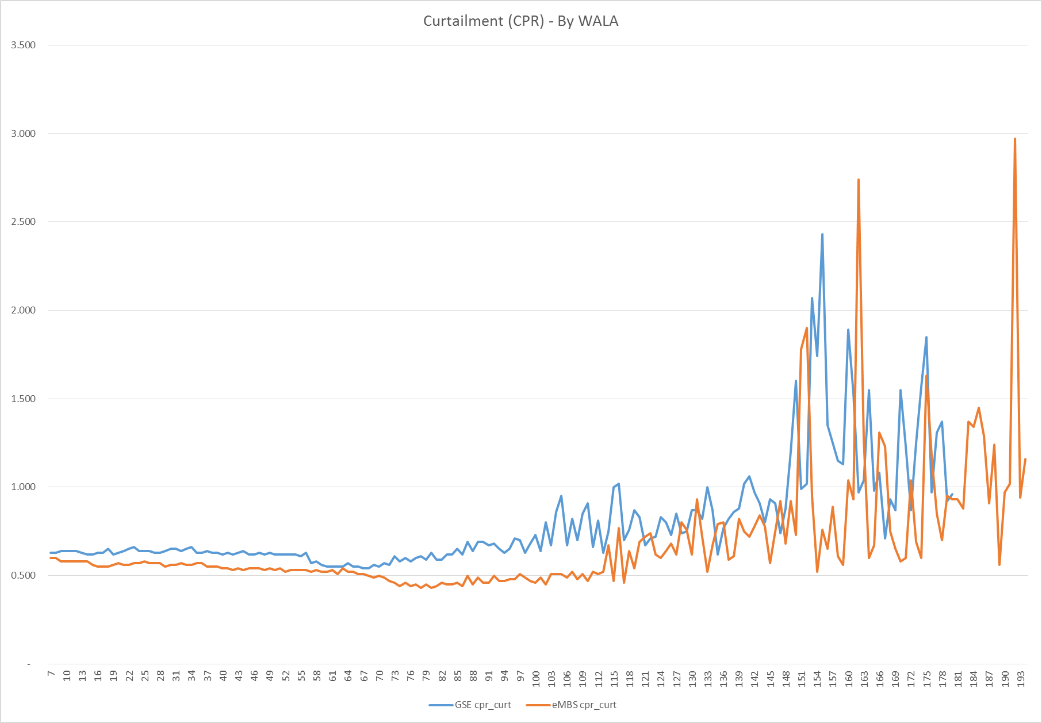
Empirical Observations and Comparisons
Calculating Curtailments (GSE, eMBS):
Using a matching algorithm we pulled 6.5 million loans from the GSE and eMBS loan level data tables
Using different calculation methods we demonstrate that the observed curtailments are comparable between the two sources
CPR
GSE is Freddie data only as the matching algorithm is much more robust

Slide 7
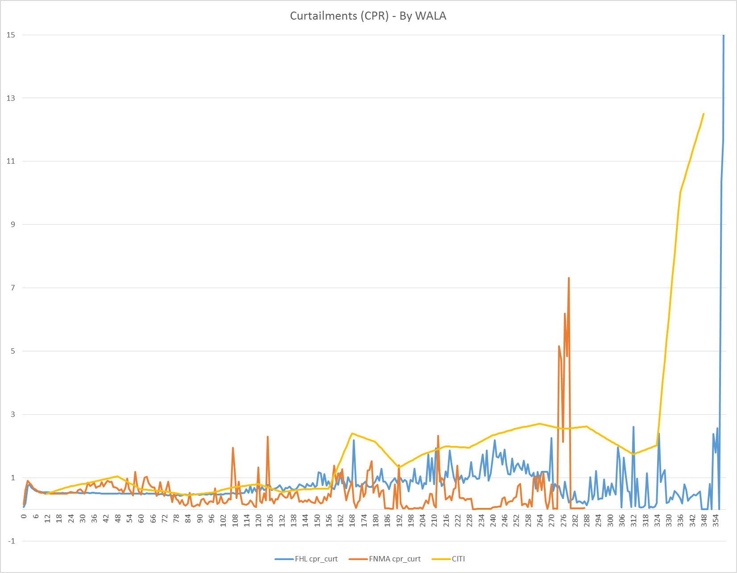
Empirical Observations and Comparisons
Observations from the Data (CITI, GSE, eMBS):
Curtailments are very low and stable for the first 12-15 years of the life of the loans
The next 10-15 years are still stable, but curtailments become more significant @1-2 CPR
The last 3 years sees a sharp increase in curtailments as the borrowers seek to eliminate debt
CPR
The eMBS data is sparse after WALA > 250

Slide 8
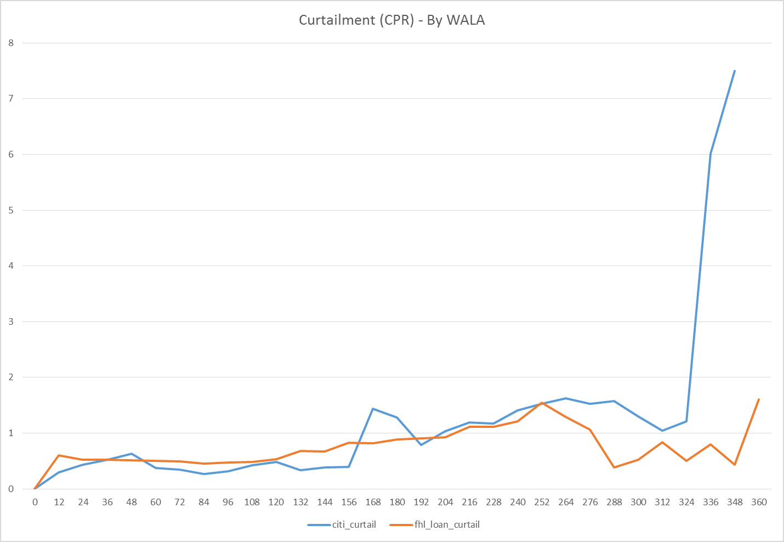
Empirical Observations and Comparisons
FHL eMBS data vs CITI data
Freddie data has loan ages up to 360 months, so we use that data to calculate curtailments
The data is very sparse for the high WALA loans
Hence we group the data into Yearly Loan Age buckets
This is easily comparable with the CITI data
CPR

Slide 9
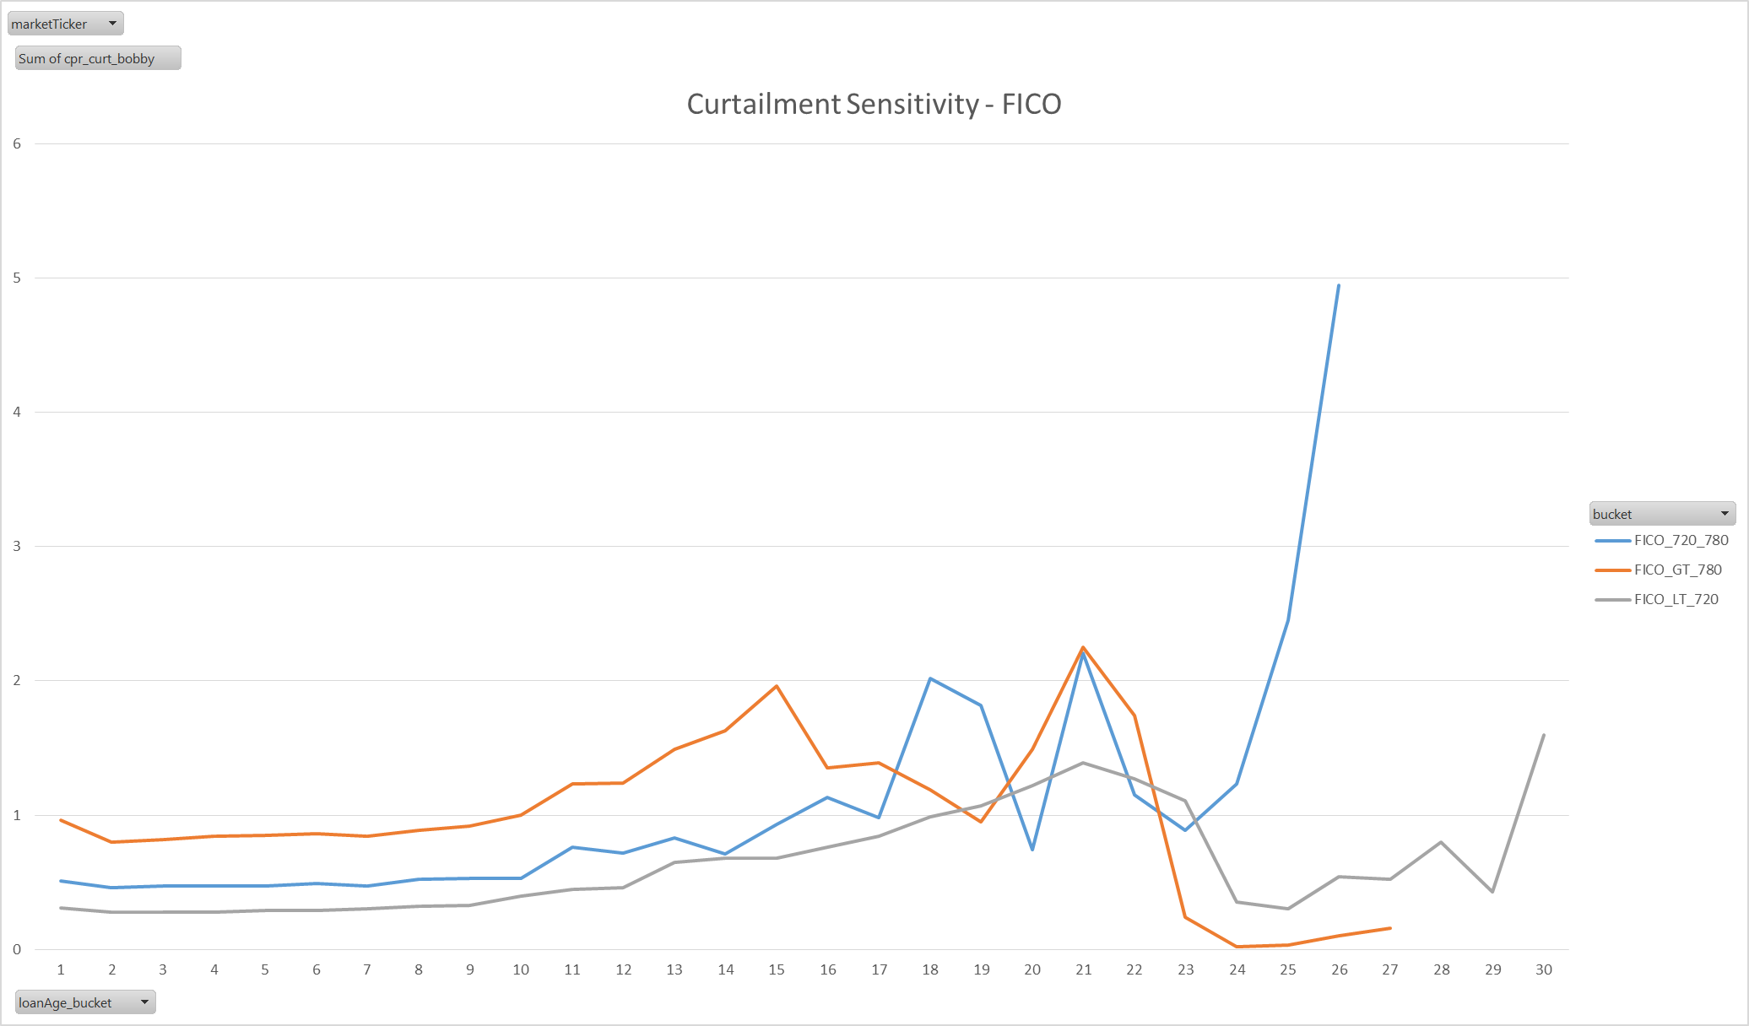
Empirical Observations and Comparisons
Curtailments Sensitivities
Curtailments are sensitive to Loan Attributes: FICO, LTV, DTI, and Loan Size
The sensitivity only seems significant for the first 10-15 years the loan (WALA <= 180)
CPR

Slide 10
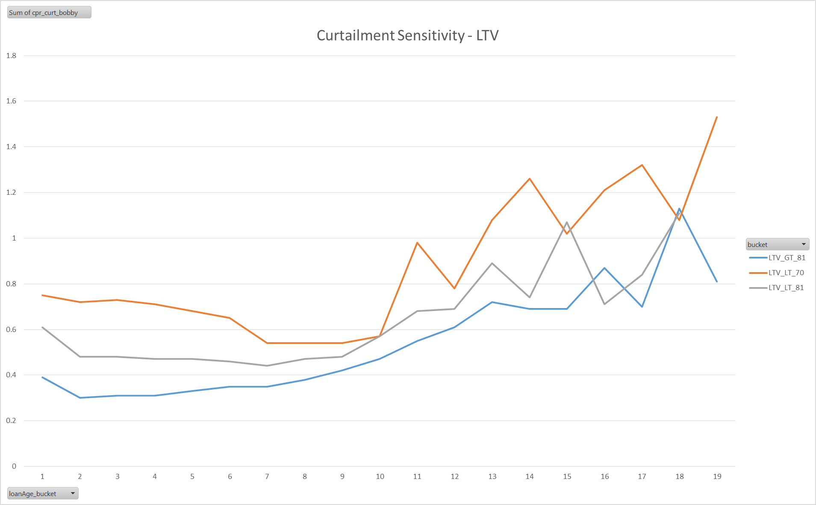
Empirical Observations and Comparisons
CPR

Slide 11
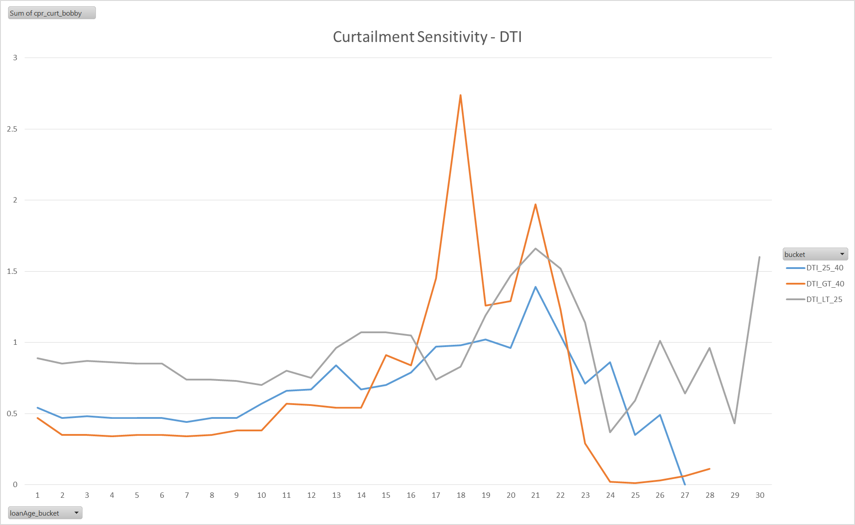
Empirical Observations and Comparisons
CPR

Slide 12
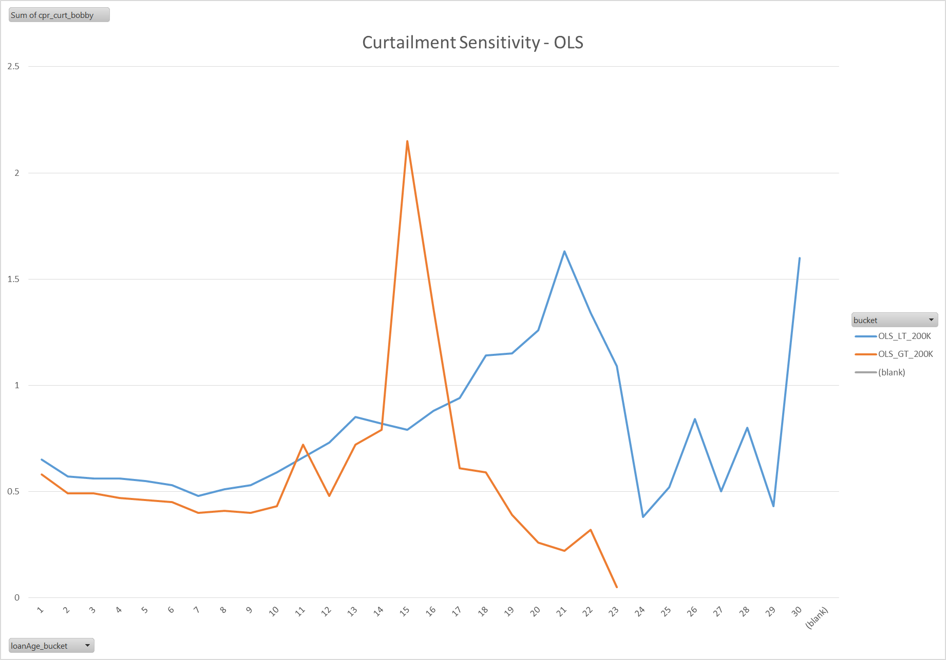
Empirical Observations and Comparisons
CPR

Slide 13
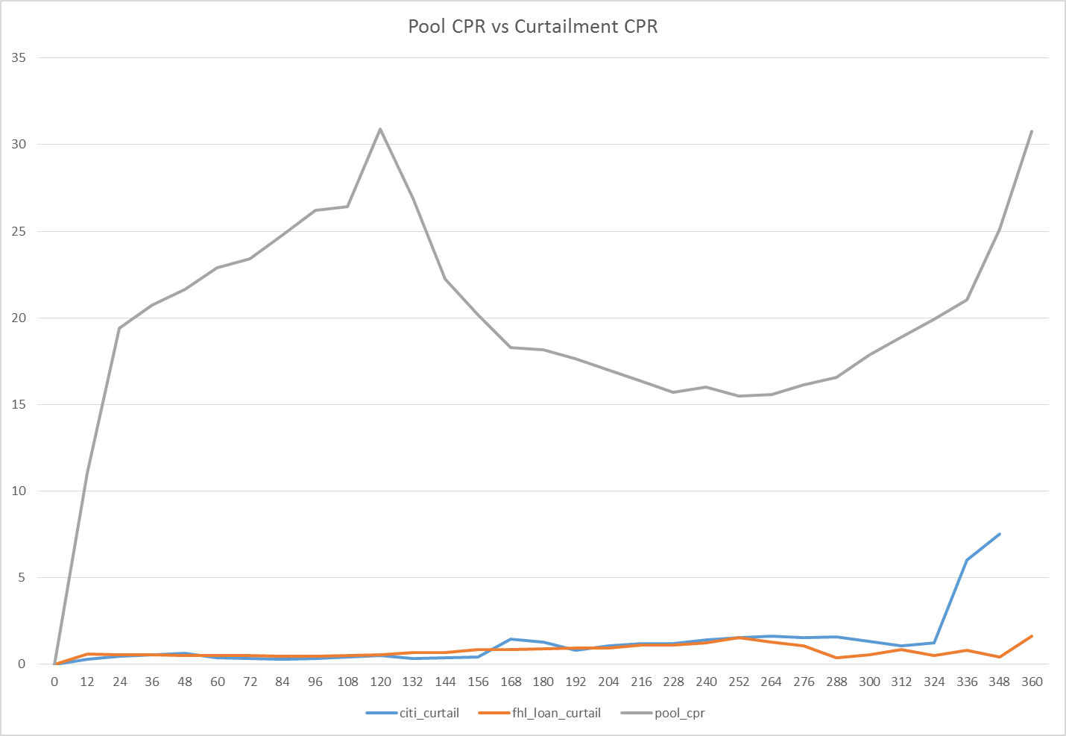
Empirical Observations and Comparisons
Final Data
We make use of the Citi Curtailment data along with the FHL Curtailment data
Additionally, we pull in the combined FHA/FNMA Pool level CPR to help capture the full payoffs that we miss from our restrictive definition of curtailment
CPR

Slide 14
Description of Framework
We use R to combine and smooth the curtailment data just described into a finalized Fixed 30 Yr curtailment vector
Curtailment is assumed to be a monotonically increasing function of WALA
It has no sensitivity to other loan attributes?
Care is taken to choose monotonically increasing data points to facilitate this assumption
Lastly, we make use of monotonically increasing spline functions to provide us with a smoothed fit to the data

Slide 15
Results
Curtailment curve and Full Payoff curves

Slide 16
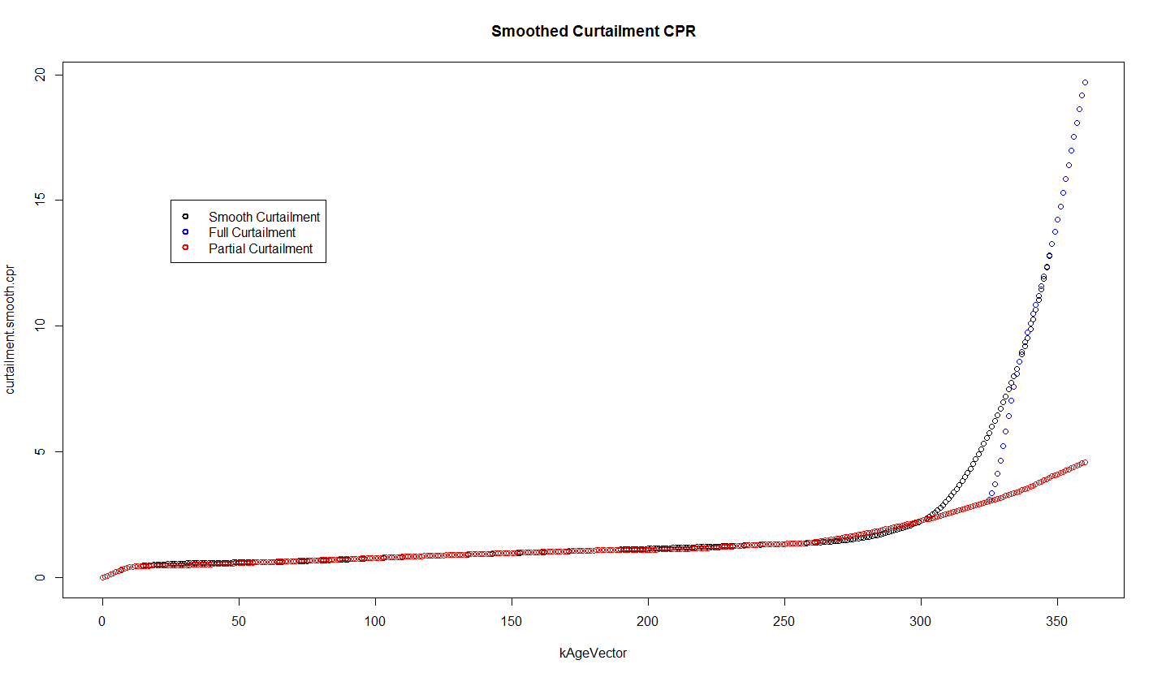
Results
Smoothed Curtailment curve from Full and Partial Curtailment curves

Slide 17
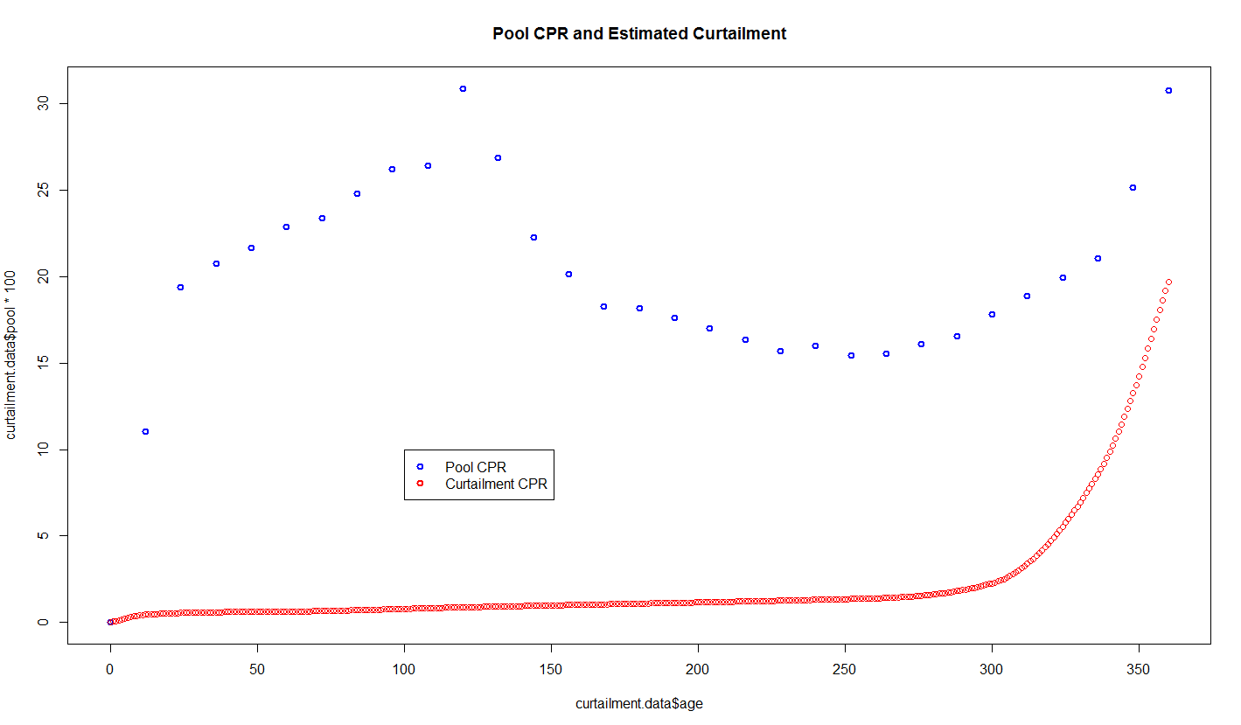
Results
Comparison of Pool CPR and Estimated Curtailment CPR Curve
Pool CPR consists of Refis, Turnover, Defaults and Curtailment

Slide 18
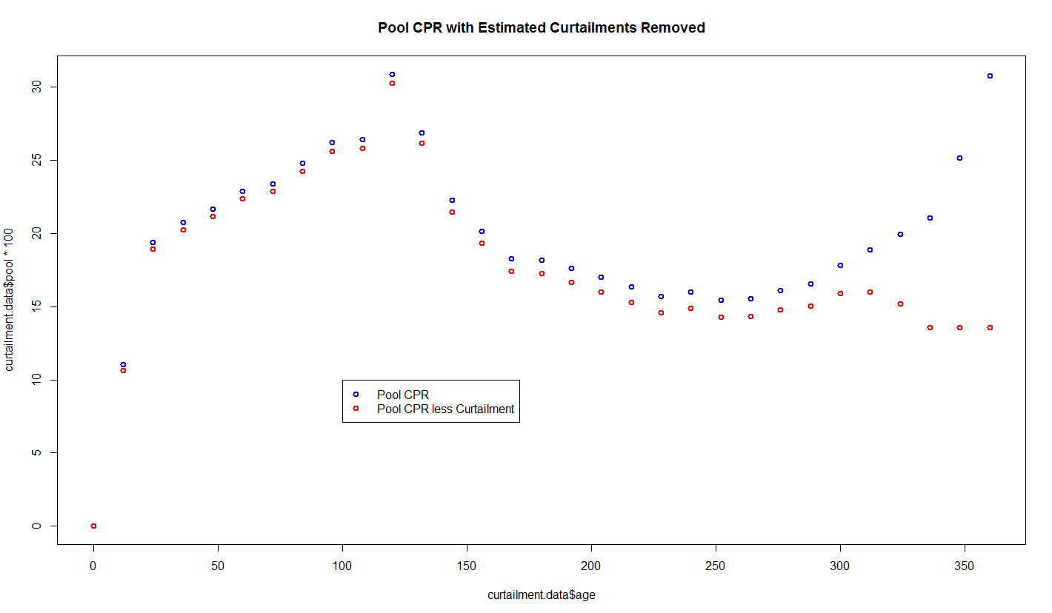
Results
Comparison of Pool CPR and Pool CPR less Estimated Curtailment

Slide 19
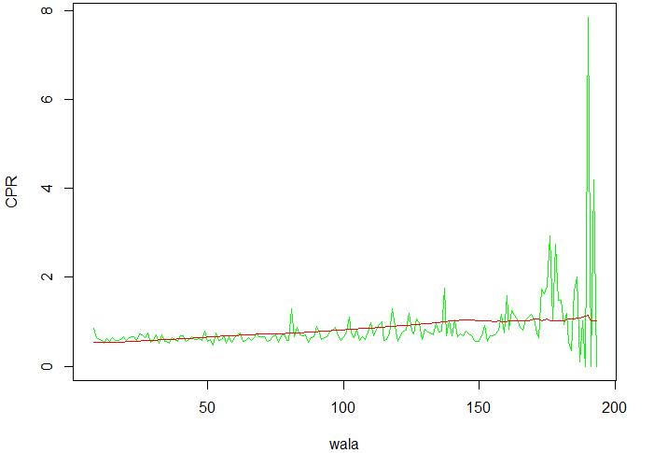
Tracking – GSE Loan Level
Running the version 1 curtailment model for the GSE loan level data set, our model shows a close result compare with the actual curtailment CPR numbers.

Slide 20
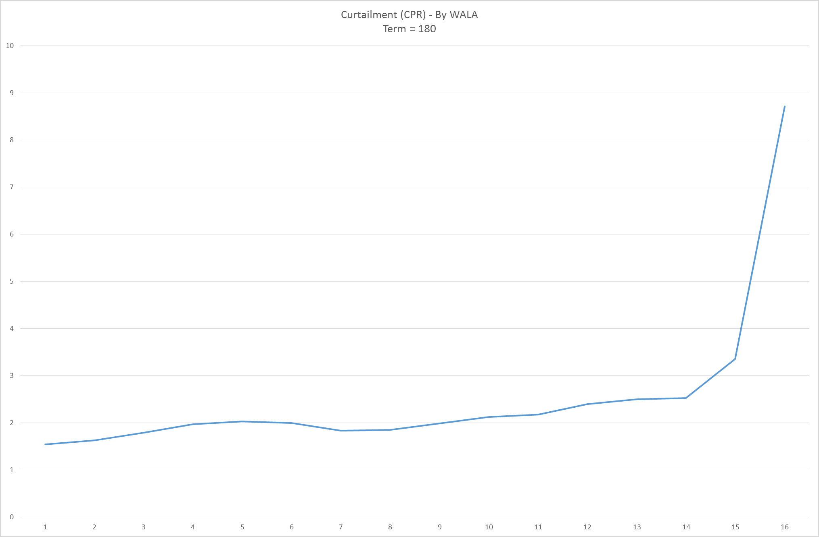
Going Forward
Loans / Pools with Term = 180

Slide 21
Decay Factor
From page 9 and 10, we can see a unclear trend of loans within different FICO and CLTV groups after around 15 years, which means the impacts of FICO and CLTV are not very clear for wala > 180. In order to capture that change based on wala, we introduced a decay factor for FICO and CLTV from wala 1 to 180.

Slide 22
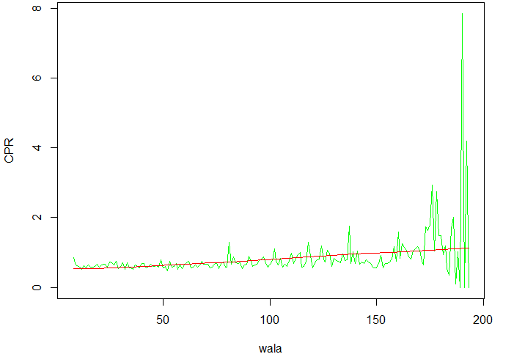
Tracking with decay factor – GSE Loan Level
Running the version 1 curtailment model for the GSE loan level data set, our model shows a close result compare with the actual curtailment CPR numbers.

Slide 23
Total Tracking Error
The combined version (FHL+FNM pools) shows our model is around 2 CRP slower before wala 125, 3.5 to 5 CRP faster than actual after 125 CPR.

